Slide 1
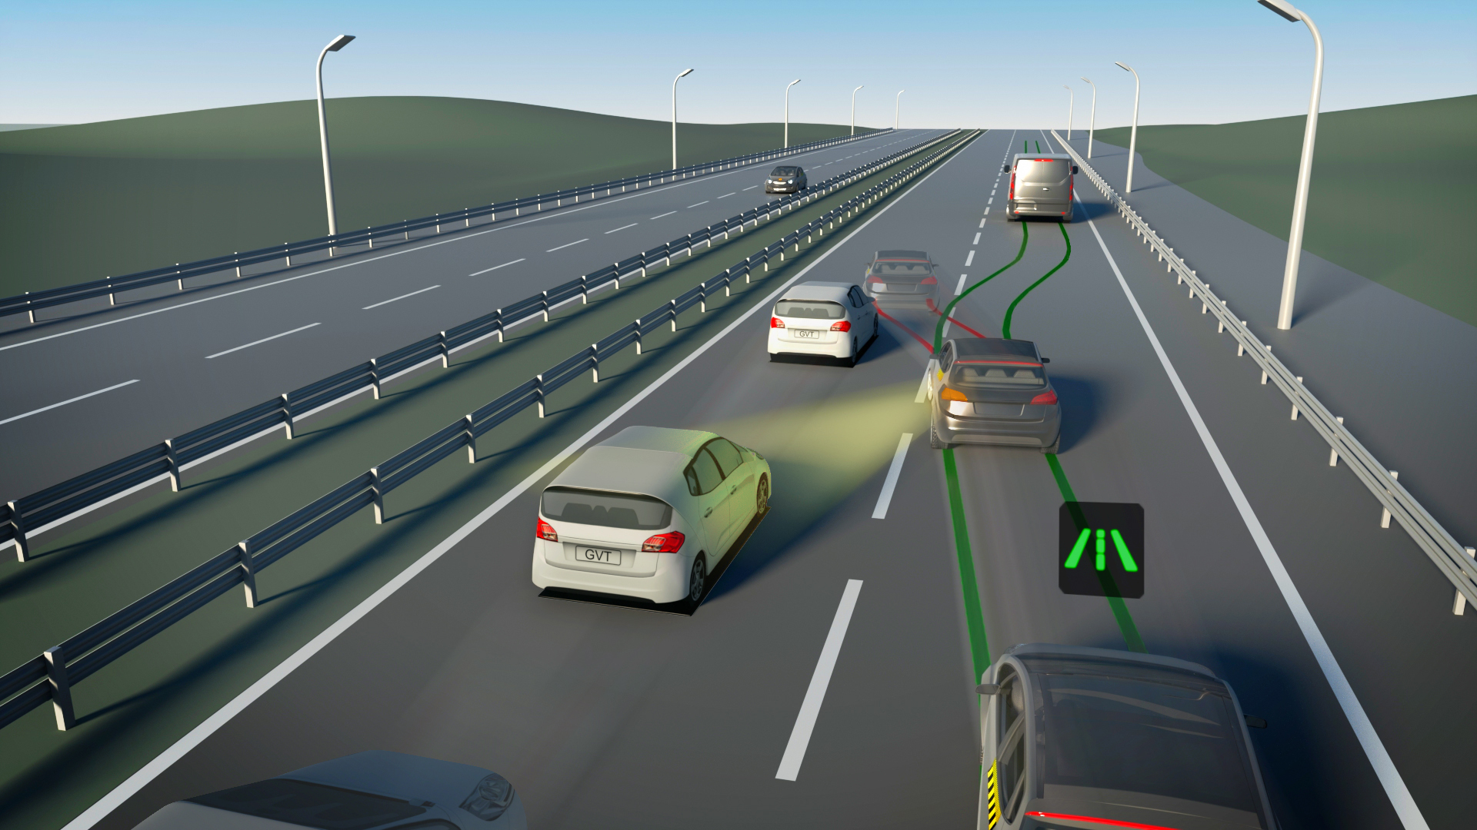
LANE-KEEPING ASSISTANCE
Group 8
Elif Cemre Durgut
Vuk Jakovljevic

Slide 2
The lane-keeping assistance (LKA) uses camera images to determine where in
the lane the vehicle is placed and adds
a slight “pull” towards the center of the lane.
The force of the “pull” is increased as
the vehicle gets closer to the edges of
the lane.
A lamp on the dashboard warns the driver when the vehicle is slowly getting close to the edge.

Slide 3
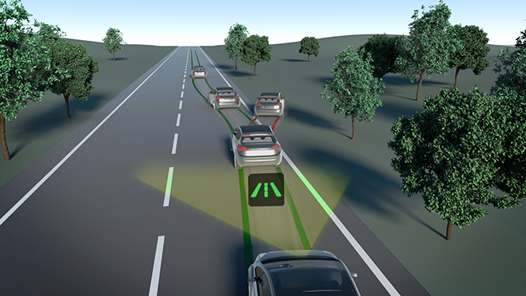

Slide 4
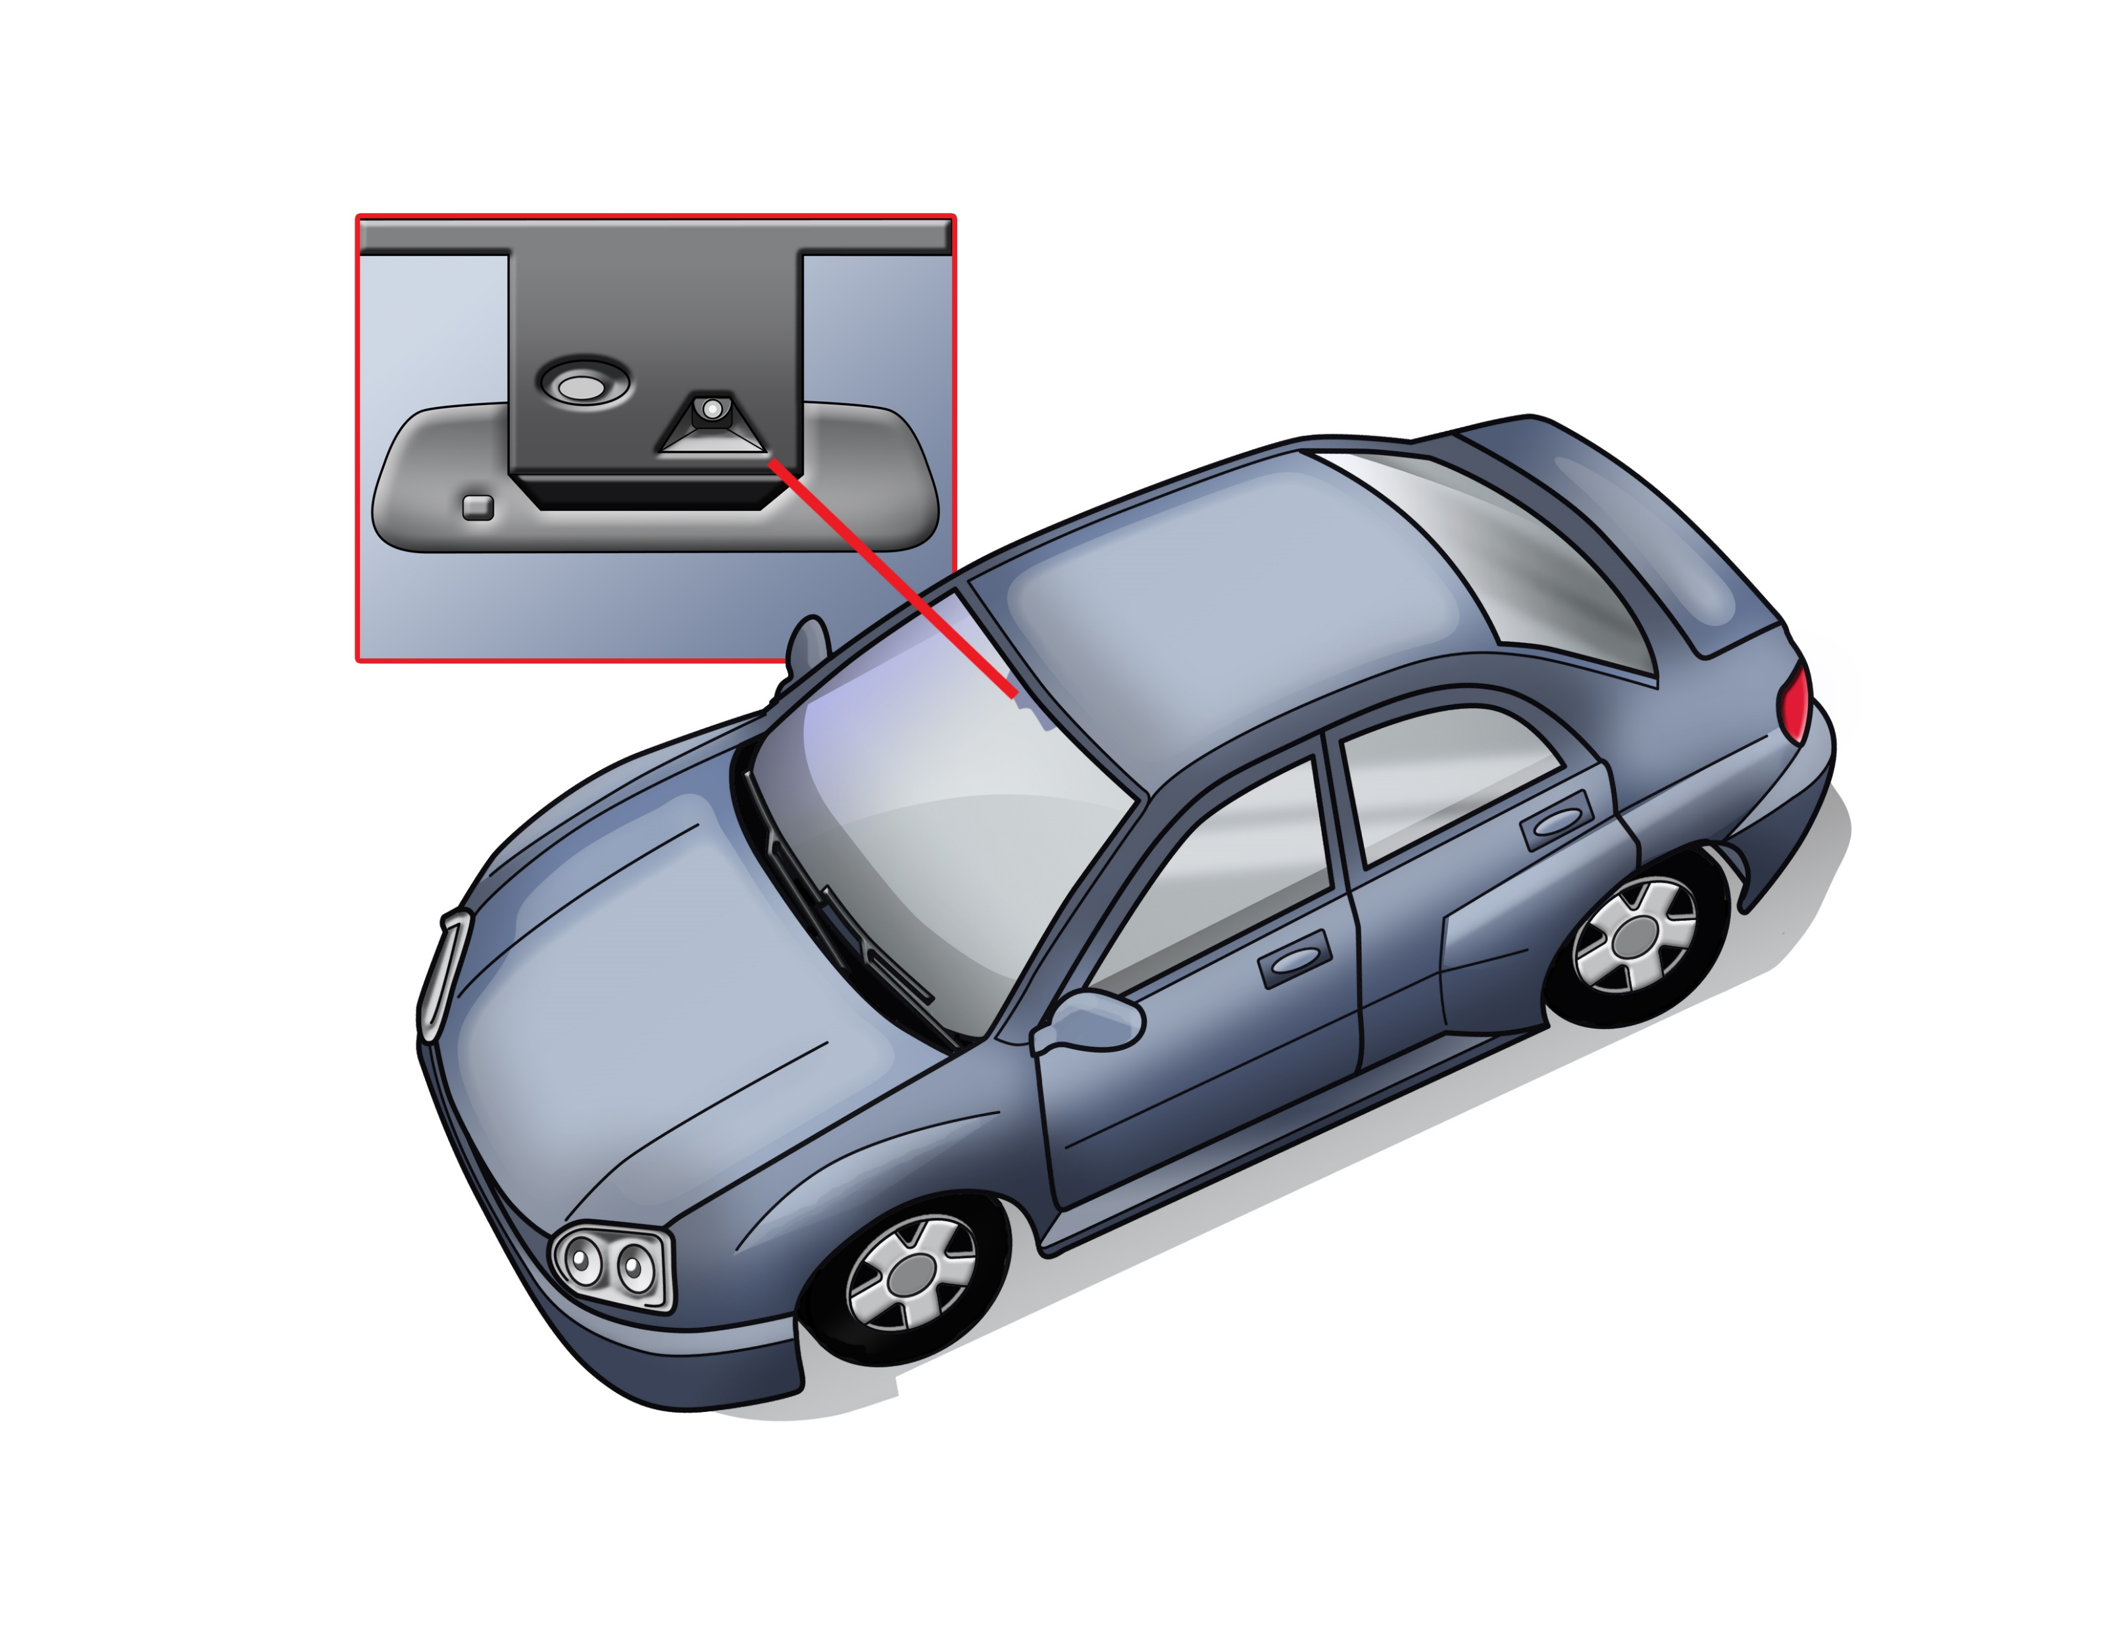
SENSORS
Lane Departure Camera
Lane departure warning uses a video camera to detect lane markings ahead of the vehicle and to monitor the vehicle's position in its lane.

Slide 5
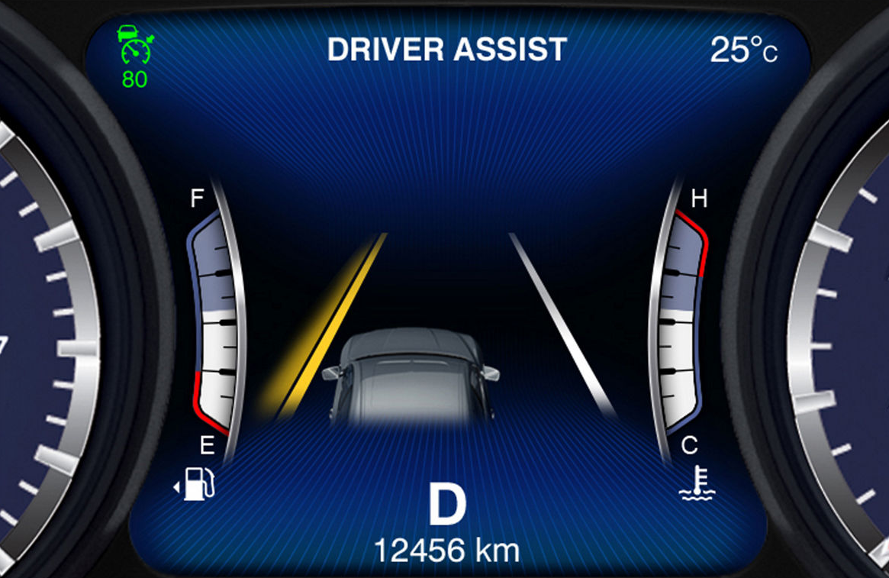
ACTUATORS
1) Control Panel
If the distance from the vehicle to the lanes falls below a minimum threshold, LKA warning sign is displayed on the car’s control panel.

Slide 6
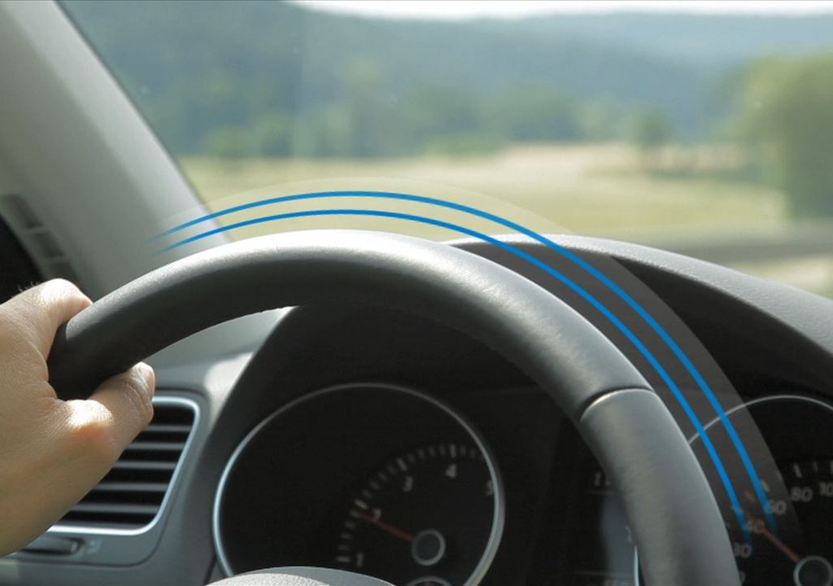
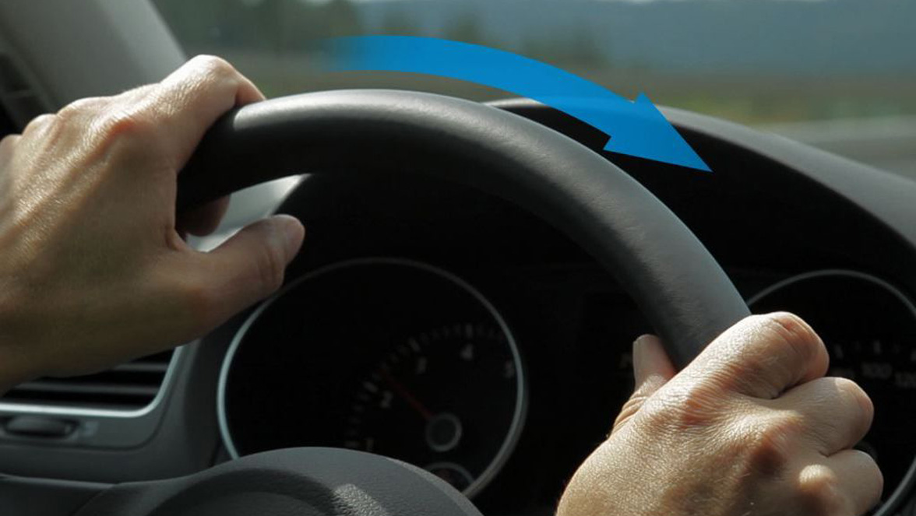
ACTUATORS
2) Steering Wheel
Vibration
Counter-steering

Slide 7
TIMING REQUIREMENTS
T1: Vibrate the steering wheel within 800 ms after the minimum defined distance from the lane is crossed.
T2: Start counter-steering within 800 ms after the distance to one of the lanes falls below the threshold.

Slide 8
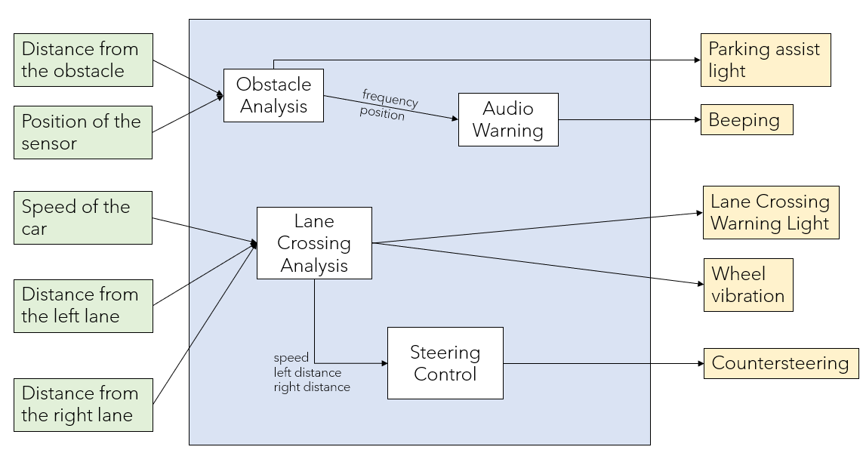
Software Design

Slide 9
Lane Crossing Analysis
if the speed < 30:
no warning
do not direct to task 2
else:
if the distance from the left lane < 50 cm or the distance from the right lane < 50 cm:
give light and vibration warnings
direct to task 2
else:
no warning
do not direct to task 2
Task Parameters:
WCET | 120 ms
Period | 400 ms
Deadline | 400 ms
Precedes | Steering Control

Slide 10
Steering Control
It determines the force to be applied for steering based on the speed of the car (inversely proportional) and the direction of the steering (in the opposite direction of the lane crossed).
Task Parameters:
WCET | 80 ms
Period | 400 ms
Deadline | 400 ms
Precedes | -

Slide 11
OUR THOUGHTS ABOUT THE PROJECT

Slide 12
THANK YOU FOR LISTENING!

Slide 13
References
https://www.euroncap.com/sv/fordonssaekerhet/foerklaring-av-betygen/foerarstoedsystem/koerfaeltshjaelp/

